Slide 1
Discrete Random Variable and Probabilities

Slide 2
Random variable
Random variables allow us to assign numerical values to random events.
Frequently, when an experiment is performed, we are interested mainly in some function of the outcome as opposed to the actual outcome itself. Ex:- sum is 7 in throwing 2 dice. These real-valued functions defined on the sample space, are known as random variables

Slide 3
Example
Suppose that our experiment consists of tossing 3 fair coins. If we let Y denote the number of heads that appear, then Y is a random variable taking on one of the values 0, 1, 2, and 3 with respective probabilities.
P{Y = 0} = P{(T, T, T)} = 1/8
P{Y = 1} = P{(T, T,H), (T,H, T), (H, T, T)} = 3/8
P{Y = 2} = P{(T,H,H), (H, T,H), (H,H, T)} = 3/8
P{Y = 3} = P{(H,H,H)} = 1/8

Slide 4

Since y must take one of the values 0 through 3, we must have

Slide 5
Three balls are to be randomly selected without replacement from an urn containing 20 balls numbered 1 through 20. If we bet that at least one of the balls that are drawn has a number as large as or larger than 17, what is the probability that we win the bet?

Slide 6
Discrete Random Variable
A random variable that can take on at most a countable number of possible values is said to be discrete.
the probability mass function p(a) of X is defined by
p(a) = P{X = a}

Slide 7

The probability mass function p(a) is positive for at most a countable number of values of a. That is, if X must assume one of the values x1, x2, . . . , then
p(x_{i}) >=0 for i = 1, 2, . . .
p(x) = 0 for all other values of x
Since X must take on one of the values x_{i}, we have

Slide 8
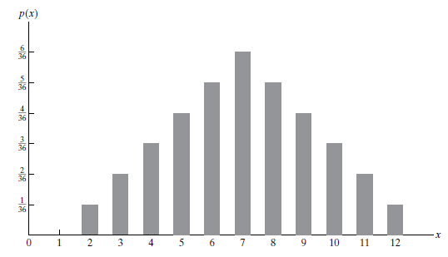
probability mass function of the random variable representing the sum when two dice are rolled

Slide 9
Distribution function
The set of all possible outcomes and their probabilities is known as probability distribution.
It tells how the total probability 1 is distributed over all possible outcomes.

Slide 10
Summarization of distribution function
Expectation
Variance

Slide 11

Expected value
the expected value of X is a weighted average of the possible values that X can take on, each value being weighted by the probability that X assumes it.

Slide 12
Calculate expectation of the random variable representing the sum when two dice are rolled

Slide 13
A school class of 120 students is driven in 3 buses to a symphonic performance. There are 36 students in one of the buses, 40 in another, and 44 in the third bus. When the buses arrive, one of the 120 students is randomly chosen. Let X denote the number of students on the bus of that randomly chosen student, and find E[X].

Slide 14
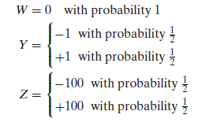
Why Expectation is not enough
Suppose there are 3 random variables w,y,z with probability mass function determined by

Slide 15
However, although E[X] yields the weighted average of the possible values of X, it does not tell us anything about the variation, or spread, of these values.

Slide 16
Variance
Variance measures the spreadness of data around the mean
If X is a random variable with mean μ, then the variance of X, denoted by Var(X), is defined by.
Var(X) = E[(X − μ)²]

Slide 17
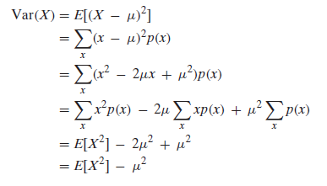

Slide 18
Calculate Var(X) if X represents the outcome when a fair dice is rolled.

Slide 19
THE BERNOULLI AND BINOMIAL RANDOM VARIABLES
Suppose that a trial, or an experiment, whose outcome can be classified as either a success or a failure is performed. If we let X = 1 when the outcome is a success and X = 0 when it is a failure, then the probability mass function of X is given by
p(0) = P{X = 0} = 1 − p
p(1) = P{X = 1} = p
where p, 0 <=p<= 1, is the probability that the trial is a success.
A random variable X is said to be a Bernoulli random variable if it follows above PMF.

Slide 20
Suppose now that n independent trials, each of which results in a success with probability p and in a failure with probability 1 − p, are to be performed.
If X represents the number of successes that occur in the n trials, then X is said to be a binomial random variable with parameters (n, p).
Thus, a Bernoulli random variable is just a binomial random variable with parameters (1, p).

Slide 21

The probability mass function of a binomial random variable having parameters (n, p) is given by

Slide 22

According to binomial theorem

Slide 23
Five fair coins are flipped. If the outcomes are assumed independent, find the probability mass function of the number of heads obtained.

Slide 24
It is known that screws produced by a certain company will be defective with probability .01, independently of each other.
The company sells the screws in packages of 10 and offers a money-back guarantee that at most 1 of the 10 screws is defective.
What proportion of packages sold must the company replace?

Slide 25

The Geometric Random Variable
Suppose that independent trials, each having a probability p, 0 < p < 1, of being a success, are performed until a success occurs. If we let X equal the number of trials required, then

Slide 26


Slide 27
An urn contains N white and M black balls. Balls are randomly selected, one at a time, until a black one is obtained. If we assume that each ball selected is replaced before the next one is drawn, what is the probability that
(a) exactly n draws are needed?
(b) at least k draws are needed?

Slide 28

The Hypergeometric Random Variable
Suppose that a sample of size n is to be chosen randomly (without replacement) froman urn containing N balls, of which m are white and N − m are black. If we let X denote the number of white balls selected, then

